Slide 1
BI MINI PROJECT CRICKET PLAYERS PERFORMANCE SYSTEM
Chandra Lekha Somisetty
189731

Slide 2
Contents
Abstract.
Introduction.
Problem statement.
Technology used.
Project design.
Schema design.
Reports.
Conclusion.

Slide 3
Abstract
This project is aimed at developing Cricket Players Performance System (CPPS).
The system will be used to check the performance of the cricketers of different countries in various types of international matches.

Slide 4
Introduction
The theme of the project is to develop Cricket Players Performance (CPP).
The project analysis contains source data, staging data and the target data.
The project follows star schema approach.

Slide 5
Problem Statement
The objective of the project is to develop cricket players performance system.
The performance of the players in all countries regarding ODI, Test and T20 matches should be calculated.

Slide 6
Technology Used
Oracle 11G/SQL Server(Database)
Informatica power center(ETL Tool)
Tableau Desktop (Reporting Tool)

Slide 7
Project Design
The design of the project is done using the source data.
The data is loaded into the target using staging.
The project contains a workflow which consists of different stages.

Slide 8
Data source
The source data contains player names, matches, bat-innings, overs and so on.
The source data contains three categories
1.ODI
2.Test
3.T-20

Slide 9
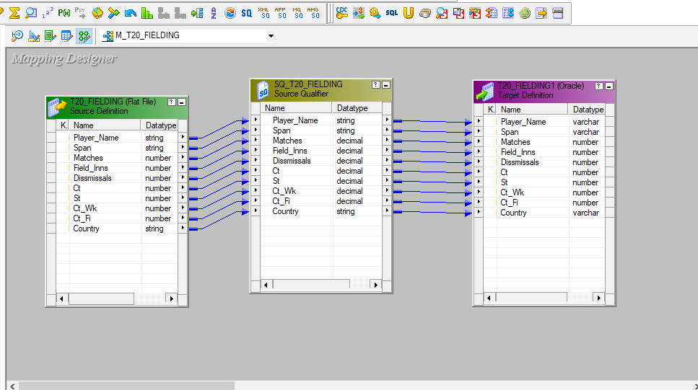
Staging

Slide 10
Dimension tables & fact tables
Two dimension tables
1.Player dimension
2.Country dimension
Three Fact tables
1.ODI_fact
2.Test_fact
3.T20_fact

Slide 11
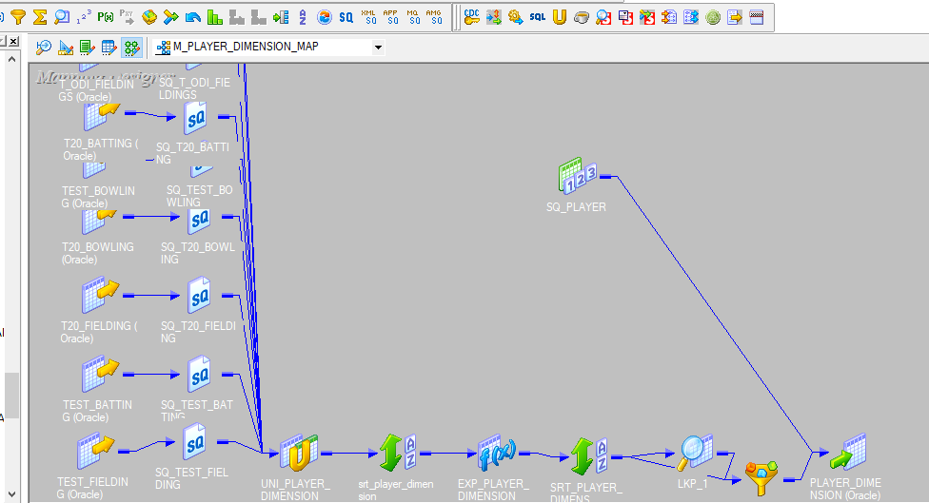
Mapping of dimension table

Slide 12
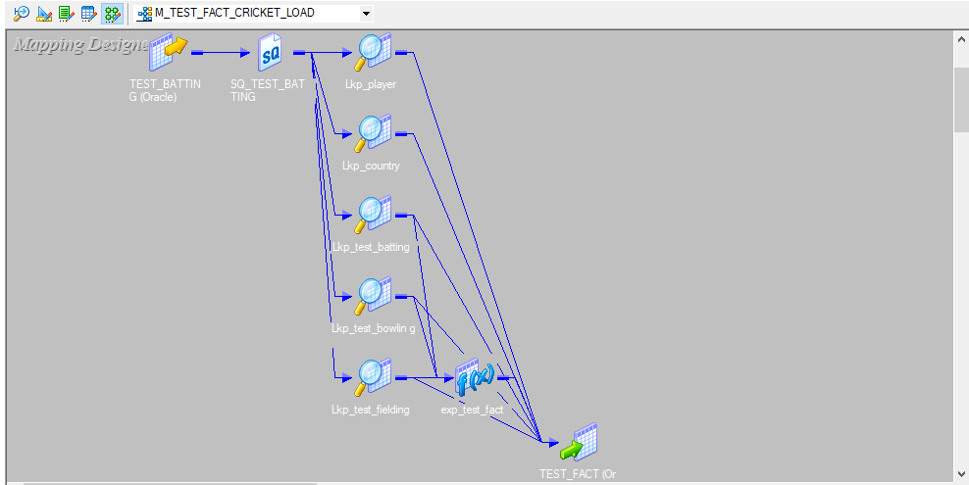
Mapping of fact table

Slide 13
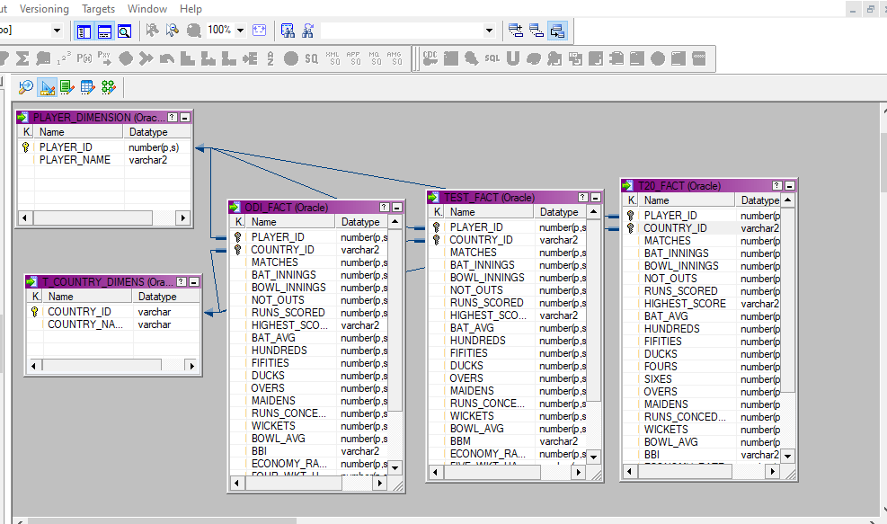
Schema design
The project follows the star schema approach.

Slide 14
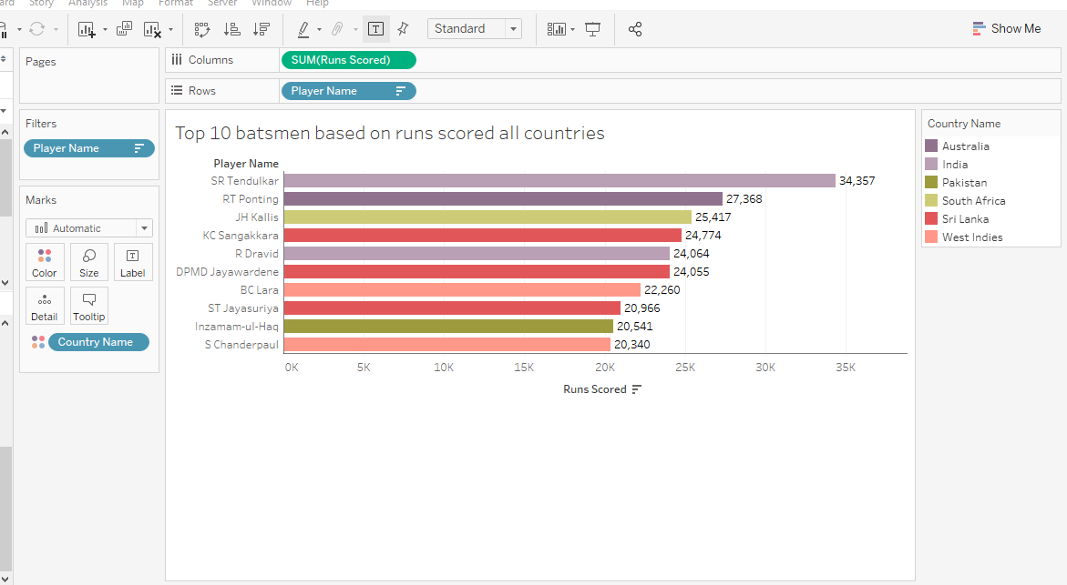
Reports
Top 10 best batsmen based on highest runs scored.

Slide 15
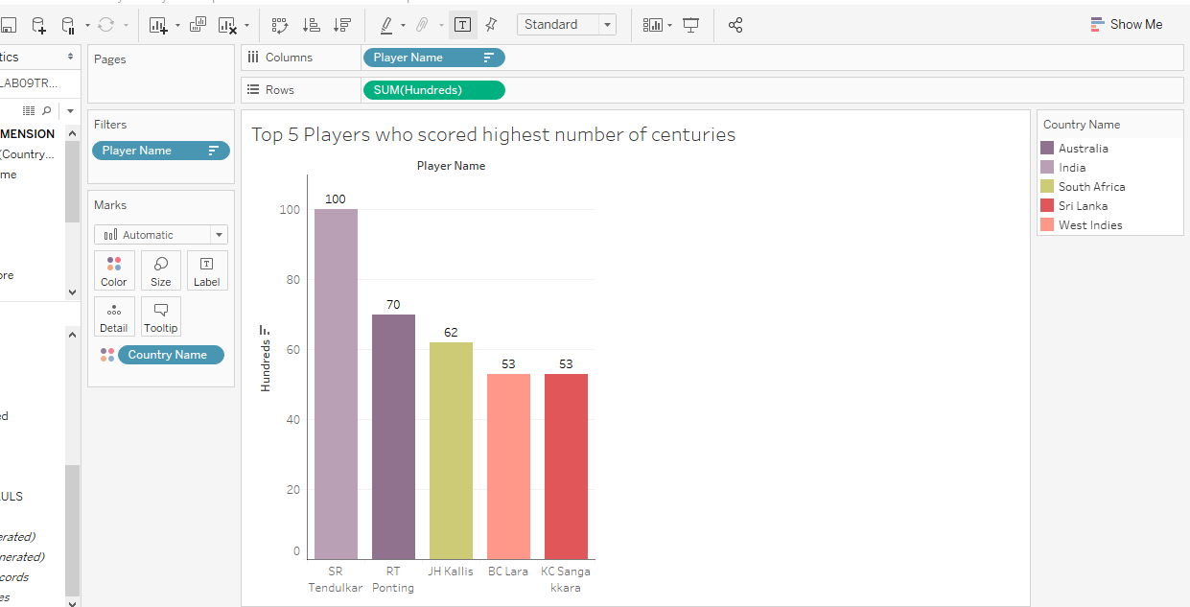
Reports
Top 5 Players who scored highest number of centuries.

Slide 16
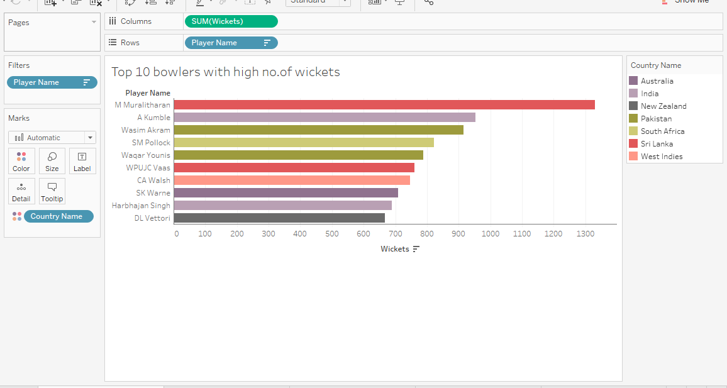
Reports
Top 10 Players who got more number of wickets.

Slide 17
Conclusion
The reports are generated based on the players performance system.
All the reports can be generated in the Tableau.
Finally, the performance of the cricket players are analyzed using the source files given.

